Slide 1
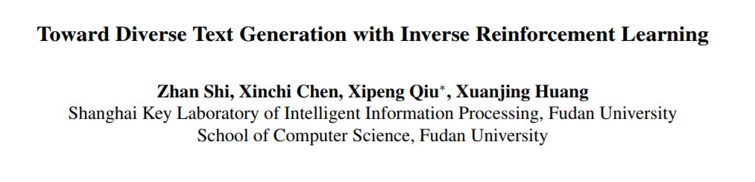
IJCAI 2018

Slide 2
Introduction
Text generation has been widely used in machine translation, image caption, text summarization and dialogue systems.
Currently, most of the existing methods adopt auto-regressive models to predict the next word based on the historical predictions. (e.g. LSTM)
However, they suffer from two problems:
Exposure bias
Inconsistency between train/test measurement
Notes:
exposure bias: training with ground truth
inconsistency: training – NLL, test - BLEU

Slide 3
Introduction
Reinforcement Learning and GAN has been used to alleviate these problems. But there are still two challenges.
Reward Sparsity
Mode Collapse
To tackle these two challenges, we propose a new method to generate diverse text via Inverse Reinforcement Learning (IRL).
Notes:
GAN generator生成非常真实的文本才会得到reward，而且Sequence GAN只有生成完一句话才有reward
mode collapse: low variance

Slide 4
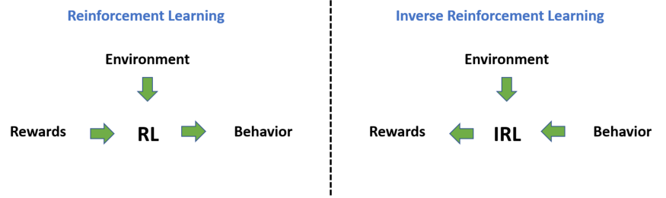
Inverse Reinforcement Learning
Input
State space, action space
Transition model P(s|s,a)
No reward function
Teacher’s demonstration: s0,a0,s1,a1,...
= trace of the teacher’s policy
Inverse RL
Can we recover Reward?
Notes:
markov process

Slide 5
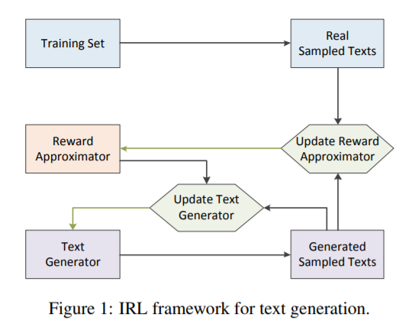
Introduction
Contributions:
regard text generation as an IRL problem
improve the problems of reward sparsity and mode collapse
propose three new metrics based on BLEU score, which is similar to precision, recall and F1
Notes:
Inverse RL to generate rewards
then RL to train generator

Slide 6
Introduction
IRL consists of two phases:
estimate the underlying reward function of experts from the training dataset
learn an optimal policy to generate texts that maximize the expected rewards

Slide 7

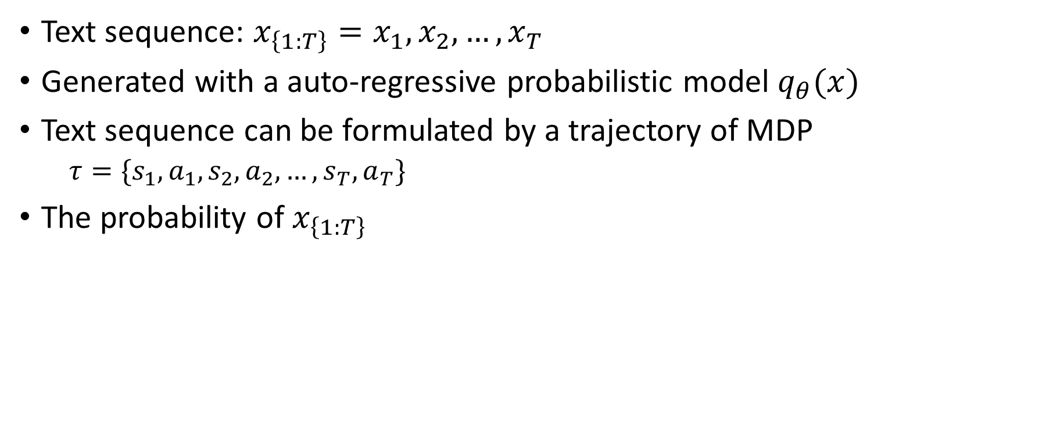
Problem Definition
Text sequence: $x_{\left\{1:T\right\}}=x_{1},x_{2},…,x_{T}$
Generated with a auto-regressive probabilistic model $q_{θ}(x)$
Text sequence can be formulated by a trajectory of MDP
$τ=\{s_{1},a_{1},s_{2},a_{2},…,s_{T},a_{T}\}$
The probability of $x_{\left\{1:T\right\}}$

Slide 8
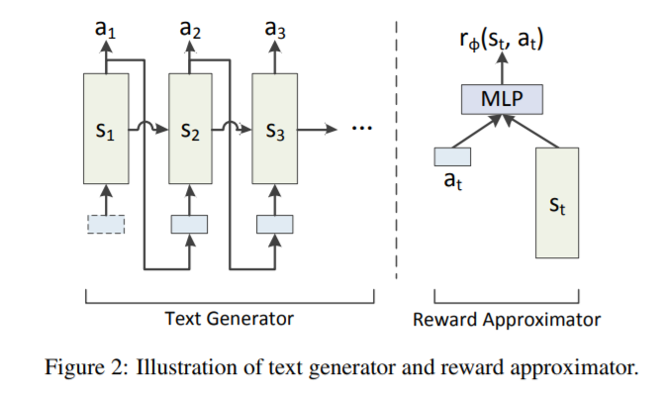

Problem Definition
Each text sequence $x$ in the training set is formulated by a trajectory $τ$ by experts from the distribution $p\left(τ\right)$
So we can learn a reward function that explains the expert behavior

Slide 9
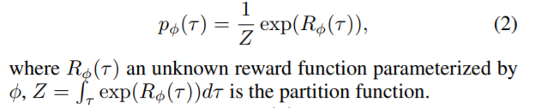

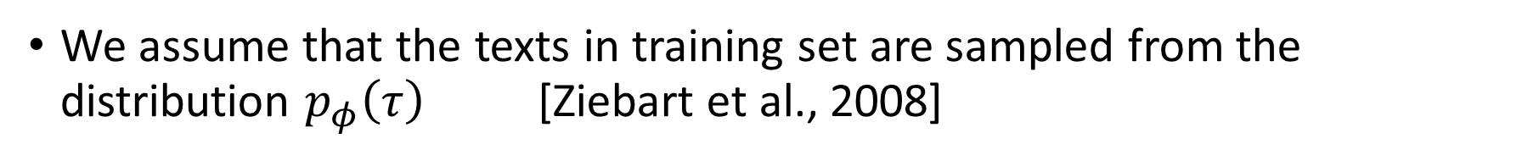
Reward Approximator
We assume that the texts in training set are sampled from the distribution $p_{φ}\left(τ\right)$ [Ziebart et al., 2008]
The reward of trajectory is assumed to be summation of rewards of each steps

Slide 10

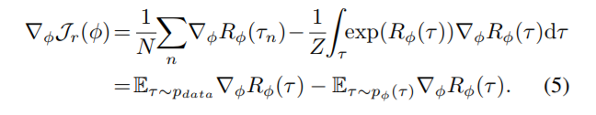
Reward Approximator
Objective of Reward Approximator is to maximize the log-likelihood
Thus, the derivative is

Slide 11



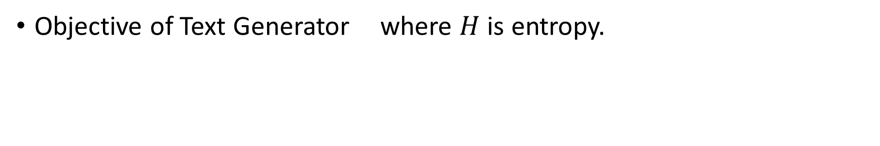
Text Generator
The text generator is formed by LSTM.
Objective of Text Generator where $H$ is entropy.
Notes:
is an entropy term, which can prevent premature entropy collapse and encourage the policy to generate more diverse texts.
KL-divergence

Slide 12


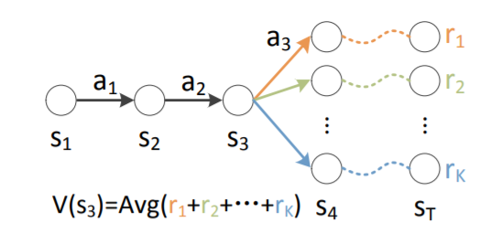
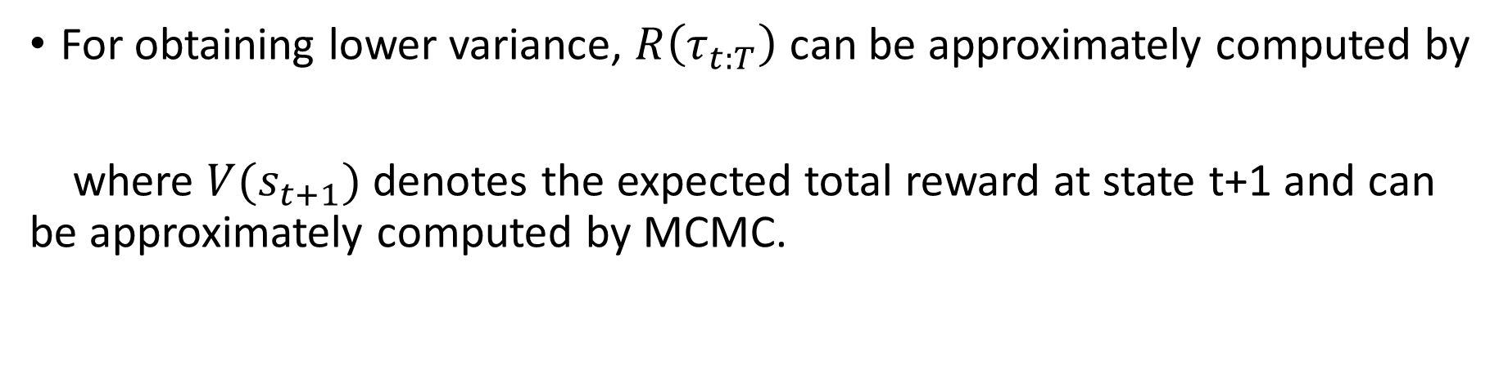
Text Generator
Thus, the derivative is [W. Zaremba et al., 2015]
For obtaining lower variance, $R\left(τ_{t:T}\right)$ can be approximately computed by
where $V(s_{t+1})$ denotes the expected total reward at state t+1 and can be approximately computed by MCMC.

Slide 13
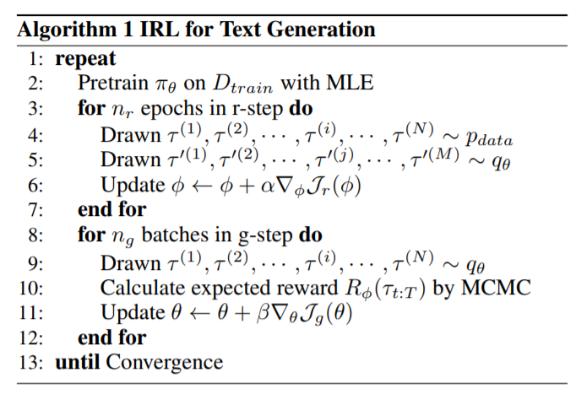
Training Algorithm
The training procedure consists of two steps:
reward approximator update (r-step)
text generator update (g-step)

Slide 14

Why Can IRL Alleviate Mode Collapse?
GANs often suffer from mode collapse, which is partially caused by the use of Jensen-Shannon divergence
So it encourages $q_{θ}(τ)$ to generate safe samples similar to the training data
Different from GANS, we use $p_{φ}(τ)$ in IRL instead of $p_{data}$. Since $p_{φ}(τ)$ never equals to zero due to its assumption, IRL can alleviate the model collapse problem.
Notes:
is an entropy term, which can prevent premature entropy collapse and encourage the policy to generate more diverse texts.
KL-divergence

Slide 15

Differences between IRL and GAN
Reward Sparsity
SeqGAN get rewards after generating a complete sequence
IRL model get rewards at each step
Mode Collapse
SeqGAN learns from data distribution $p_{data}$
IRL generates texts under the guidance of reward approximator
Notes:
is an entropy term, which can prevent premature entropy collapse and encourage the policy to generate more diverse texts.
KL-divergence

Slide 16
Experiment - Dataset
Synthetic Oracle
simulated data generated by a randomly initialized LSTM
10000 samples of length 20 or 40
use the oracle model to evaluate the generator by NLL
COCO image caption
image description pairs, length between 8 and 20
80000 texts as training set, 5000 as test set
vocabulary size is 4939, average length is 12.8
IMDB movie review
80000 sentences for training and 3000 for testing
selected sentences with length between 17 and 25
set word frequency at 180 and remove sentences with low freq words
Notes:
IMDB long

Slide 17
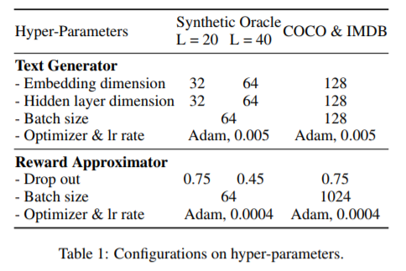
Experiment
Training Details

Slide 18
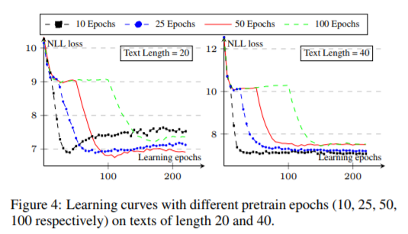
Experiment - Synthetic
Learning curves with different pretrain epochs

Slide 19
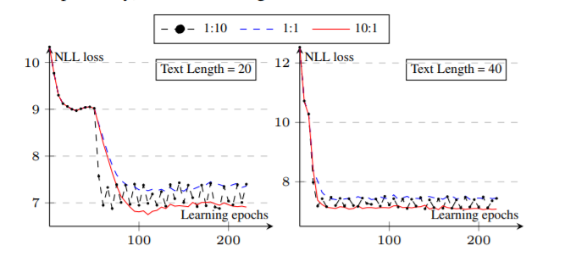

Experiment - Synthetic
Learning curves with different $n_{r} :n_{g}$
Sufficient training on the approximator lead to better results

Slide 20
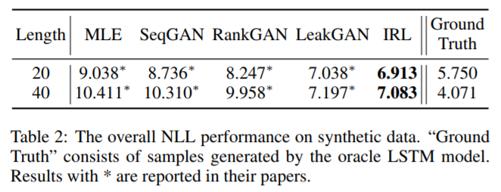
Experiment - Synthetic
Performance

Slide 21
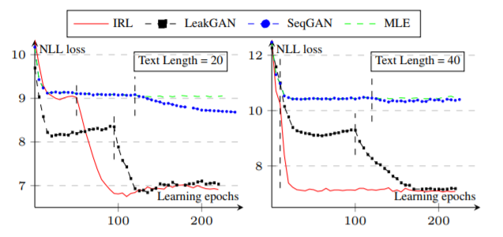
Experiment - Synthetic
Performance
Notes:
Analysis, instant rewards at each step, addresses the reward sparsity issue, dense learning signals – learn distribution of training set efficiently

Slide 22
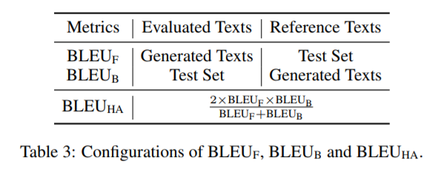

Experiment - COCO
New Evaluation Measures on BLEU
Forward BLEU ($BLEU_{F}$) uses the testset as reference, and evaluates each generated text with BLEU score
Backward BLEU ($BLEU_{B}$) uses the generated texts as reference, and evaluates each text in testset with BLEU score
$BLEU_{HA}$ is the harmonic average of the above
Notes:
Acc Recall F1

Slide 23
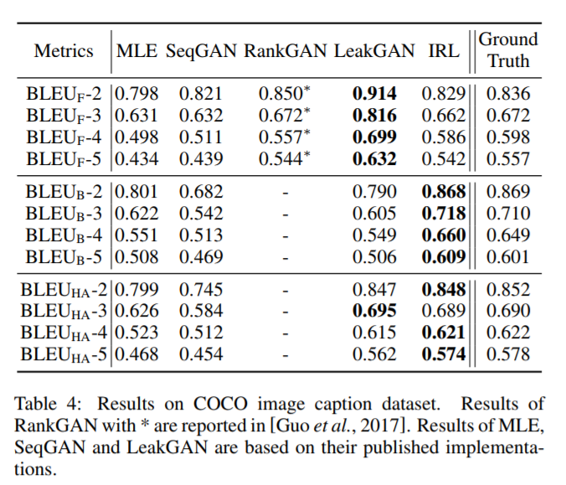
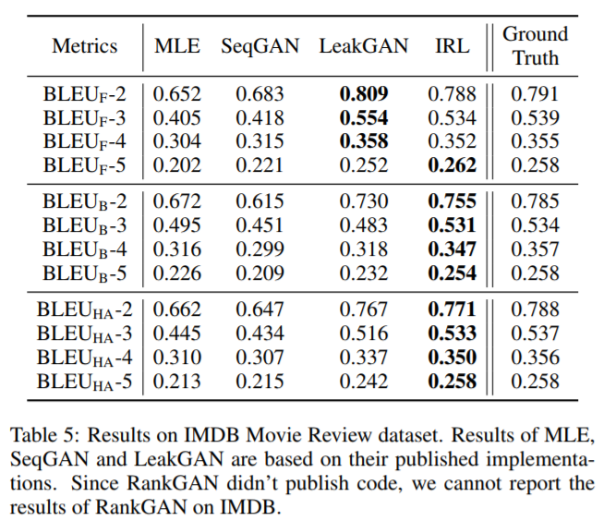
Experiment – COCO and IMDB
Results

Slide 24
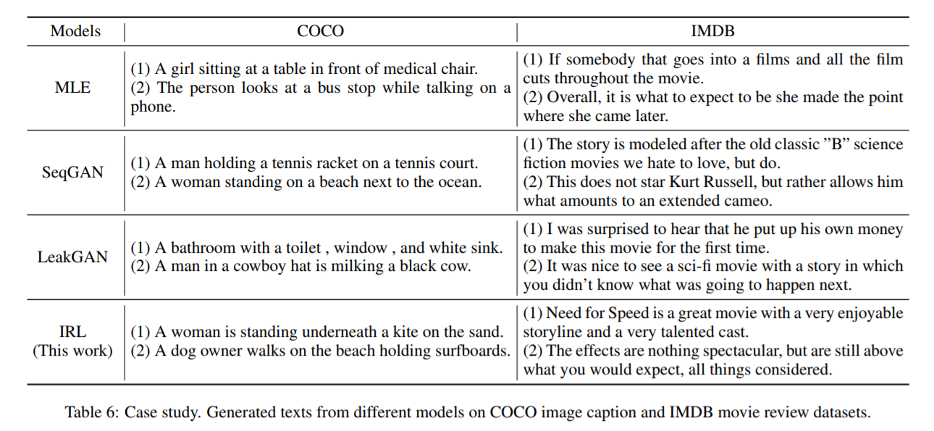
Turing Test & Case Study
Notes:
the generated sentences of our method have better quality than those generated by MLE, SeqGAN and LeakGAN, especially for long texts.

Slide 25
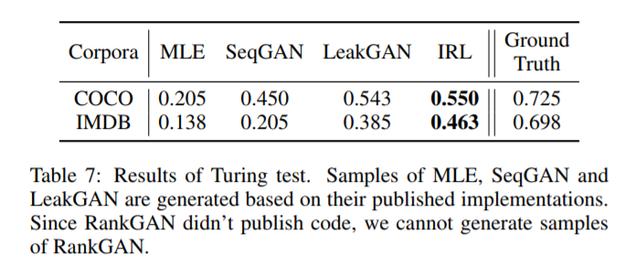
Turing Test & Case Study
We sample 20 sentences by each generator from different methods
And ask 20 different people to score it: 1 for real text and 0 for generated

Slide 26
Conclusion & Future Work
Conclusion
A new method for text generation by using IRL
Alleviates the problems of reward sparsity and mode collapse
Propose three new evaluation measures based on BLEU
Future Work
Generalize the IRL framework to other NLP tasks
machine translation, summarization, question answering, etc

